Slide 1
Tritium MySQL Database How To
Tyler Hague

Slide 2
How to connect
Log into an a-onl machine and type:
mysql -u triton-user -p -h halladb triton

Slide 3
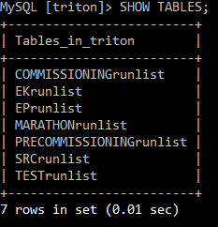
What tables are there?

Slide 4
What is in each table?
run_number
run_type
start_time
end_time
target
raster_x
raster_y
beam_energy
momentum
angle
prescale_T1
prescale_T2
prescale_T3
prescale_T4
prescale_T5
prescale_T6
prescale_T7
prescale_T8
comment
end_comment

Slide 5
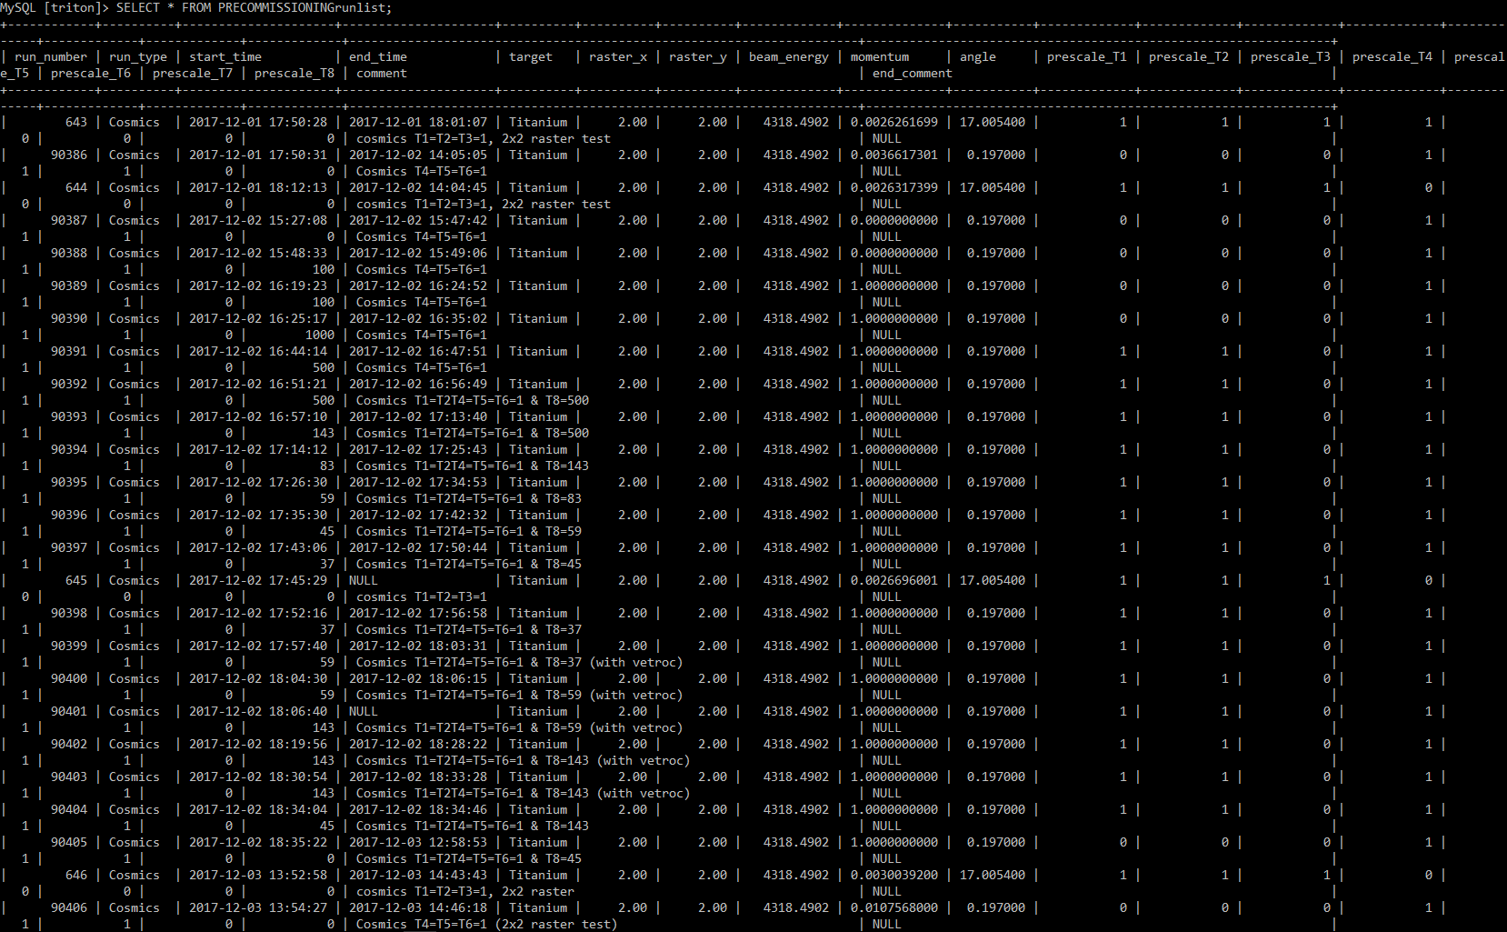
Let’s take a look at a table
Here’s the PRECOMMISSIONINGrunlist table

Slide 6
Let’s take a look at a table
Here’s the PRECOMMISSIONINGrunlist table
Oh no… that’s pretty overwhelming. Let’s see how we can cut down on this info.

Slide 7
I want to see some runs with the clock on
I want to know what runs have the clock on. Also, I’m only interested in the run number and target. How do I do that?

Slide 8
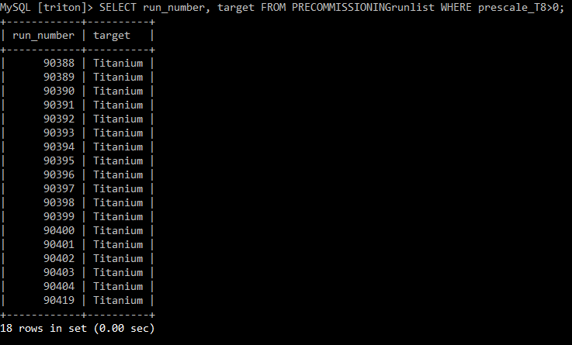
I want to see some runs with the clock on
I want to know what runs have the clock on. Also, I’m only interested in the run number and target. How do I do that?
Much better.

Slide 9
Another example
I noticed something weird in some data for run 90418. Now I want to see if the shifters put any comment info and look at logbook entries around the same time. What ever am I to do?

Slide 10
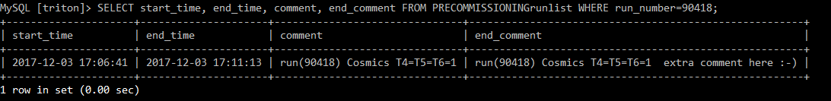
Another example
I noticed something weird in some data for run 90418. Now I want to see if the shifters put any comment info and look at logbook entries around the same time. What ever am I to do?
Now I can narrow down a time window in the logbook to search within.
I’m so glad the shifter was on the ball and gave me and extra comment!

Slide 11
What if I don’t want it sorted by run number?
I want to see run number and target info for the clock trigger again. But now I want it sorted by the prescale value of the clock trigger. Surely I don’t have to keep scrolling until I find the highest clock rate?!

Slide 12
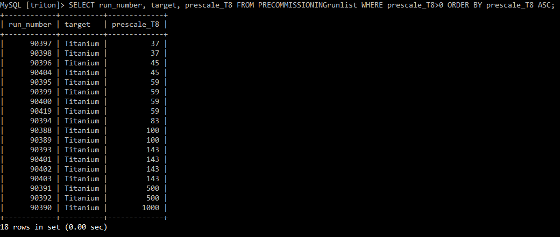
What if I don’t want it sorted by run number?
I want to see run number and target info for the clock trigger again. But now I want it sorted by the prescale value of the clock trigger. Surely I don’t have to keep scrolling until I find the highest clock rate?!

Slide 13
What if I don’t want it sorted by run number?
I want to see run number and target info for the clock trigger again. But now I want it sorted by the prescale value of the clock trigger. Surely I don’t have to keep scrolling until I find the highest clock rate?!
… But I wanted slowest clock rate first ☹

Slide 14
There’s a command for that.

Slide 15
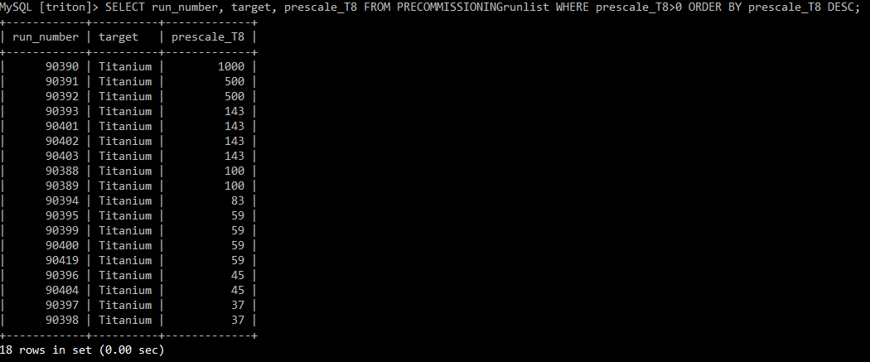
There’s a command for that.

Slide 16
There’s a command for that.
#EasyPeasy

Slide 17
In conclusion
SQL is a powerful tool for storing and searching through a vast quantity of data. A python script, triggered by starting and stopping CODA, ensures that our runlist is kept up to date and ready to help us through our analysis.
Through the use of SELECT commands, you can find any type of run that you need.
This is only a brief overview of a few things that you can do with SQL. Google has a vast wealth of knowledge available to teach you how to query SQL as much as your heart desires.
The account that you use to access the database is read-only. MySQL doesn’t confirm commands. An errant command could delete all info in the database without batting an eye.
Now go forth and run your experiment. And don’t forget the semicolons. ;)

Slide 19
But I really want to make changes/add info/do something that requires write-privileges
If that’s the case, you should install mysql on your personal machine.
Individual tables (or the whole database) can be exported and then imported into another mysql installation.
If you want to have something exported for you to take and play with, let me know.
I will try to export individual experiment tables after each run period. If I forget (which I probably will), remind me.

